Slide 1
2023 Population and Housing Census in Albania The use of new technologies for the Population and Housing Census experience of Albania

Slide 2
Outline
Organizational Structure
Three Areas of Innovation
IT duties and responsibilities
IT Activities
Modernisation
Data transfer and Security
GIS duties and responsibilities
Investment in GIS system infrastructure
Data collection map application

Slide 3
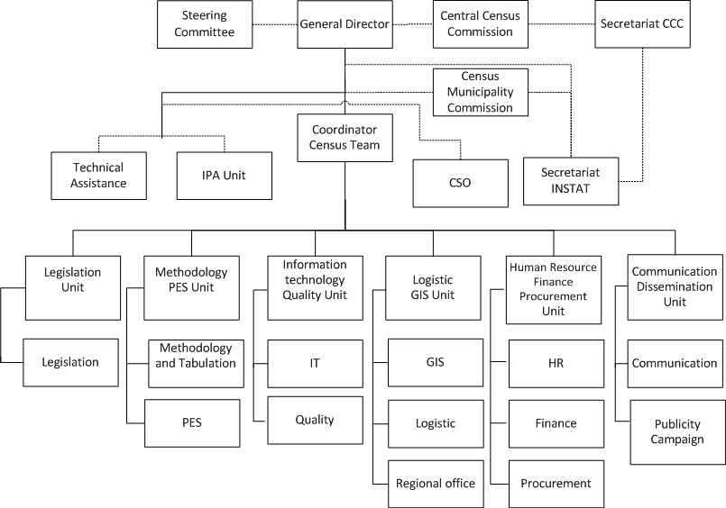
Organizational Structure

Slide 4
Three Areas of Innovation
Geographic Information
Reengineering geographic information system (GIS)
data collection, monitoring, analysis, dissemination
Population Data
Investing on Register-based census
utilizing 2020 census as a base for creating Statistical Population Register
Use of Technology
Establishing a sustainable system for CAPI data collection
useful not only for census but in the future for other statistical activities

Slide 5
IT duties and responsibilities:
Census hardware and software environment
Census databases / interfaces
IT systems and training of users of these systems
Census back up system
Coordinate and cooperate for IT processes with other units and INSTAT staff within the organization of work for the Census
Notes:
Plan, implement, monitor and timely maintain Census hardware and software environments.
Plan, build and monitor databases as needed as well as various interfaces.
To plan and test IT systems as well as to organize training of users of these systems.
Plan and build a sustainable back up system.
To coordinate and cooperate for IT processes with other units and INSTAT staff within the organization of work for Cens.

Slide 6
IT Activities
Strategy for data collection and security
IT infrastructure and backup
Development of CAPI application
Development of applications for monitoring
Development of applications for supporting HR and Logistics
Training on the use of tablets / applications
Support to the fieldwork staff
Headquarters staff
IT supervisors
Real-time updating of apps in cases of changes
Pre
enumeration
Enumeration
Post
enumeration
Matching Census and PES results
Support in data editing and imputation
Support in data analysis and final Cens results
Support in data preparation for dissemination

Slide 7
Modernisation
Use of technology in all phases and sub-processes of the Census
Monitoring based on quality and performance indicators
Strategy for quality assurance and data quality
Quality Management Plan
High quality and real time data

Slide 8
Data transfer and Security
Real-time synchronisation of data from the tablet directly to INSTAT servers
Update of CAPI applications in the field by downloading the latest versions from the server
Sustainable back up system
Data transfer protocols will be designed with specific security features, including encryption
Confidentiality will be protected throughout the statistical production process
Notes:
Plan, implement, monitor and timely maintain Census hardware and software environments.
Plan, build and monitor databases as needed as well as various interfaces.
To plan and test IT systems as well as to organize training of users of these systems.
Plan and build a sustainable back up system.
To coordinate and cooperate for IT processes with other units and INSTAT staff within the organization of work for Cens.

Slide 9
GIS duties and responsibilities:
Defining census enumeration areas and approximation with administrative boundaries
Identification of buildings, dwellings and entrances
Geo-codification and codification of geospatial units
Preparation of maps for Census
Support on the development of the GIS monitoring system for the Census
Real-time updating of EAs in case of changes
Field staff support for any ambiguities
Preparation of maps for the Post Enumeration Survey (PES)
Publication of Census results and other spatial analyses

Slide 10
GIS
Training on the use of maps
Support the data collection phase in order to eliminate overlap of census areas
Support field-orientation of enumerators by recruited GIS support staff
Real-time updating of areas in cases of changes
Strategy for census GIS
Investment in GIS infrastructure
Update of Geo-database 2017-2021
Quality controls of buildings and dwellings and digitalization
Update of EA boundaries
Codification of EAs and Buildings
Preparation of geo- information for tablets for Pilot and Census
Pre
enumeration
Enumeration
Support in data analysis and final Cens results
Thematic maps and census atlas
Census data in the INSTAT Geo-portal
Creating "Story Map" maps
In-depth analyses through the geographical component
Grid level maps according to Eurostat recommendations
Preparation of geo-database and maps for the Post Census Survey;
Post
enumeration

Slide 11
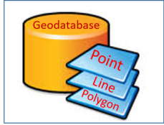
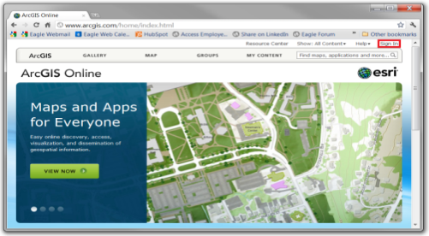
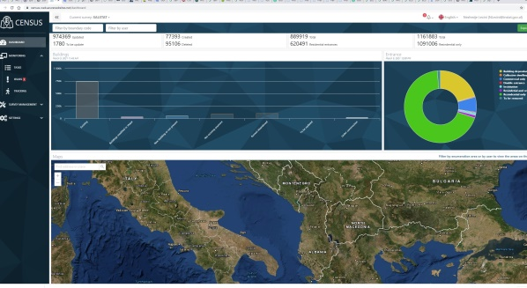
Investment in GIS system infrastructure
Database
ArcGIS Online
Web map, Attributes & Dashboard
Desktop 10.7
Creating,
Editing
Dashboard
Planning, Distribution and Monitoring
Server
Notes:
GIS activities are carried out through GIS software dedicated to geospatial data. As the use of ArcGIS software was successful in carrying out the activities of all phases of the 2011 CENSUS, INSTAT has made the necessary investments in GIS technology to support the next census. Arcgis software licenses have been updated with all the necessary platform (10.8 Version), which is very necessary for creating and using maps, for storing and managing data in databases and servers, for processing and analyzing data, distributing maps ect. Through ArcGIS online. Also was developed a personalized mobile application for the collection of geospatial data, and computer monitoring system (dashboard).

Slide 12
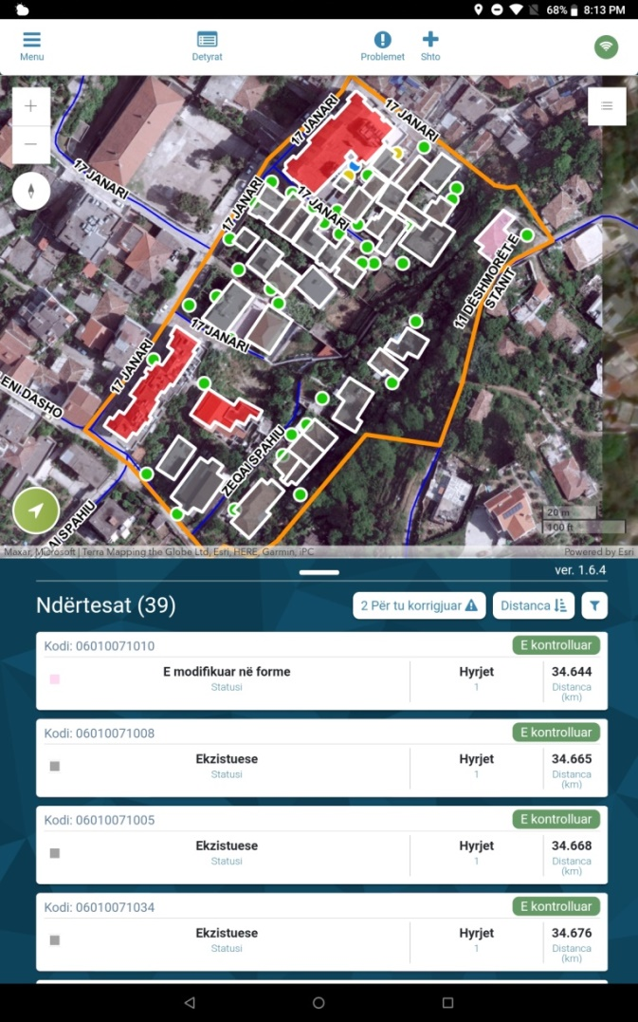
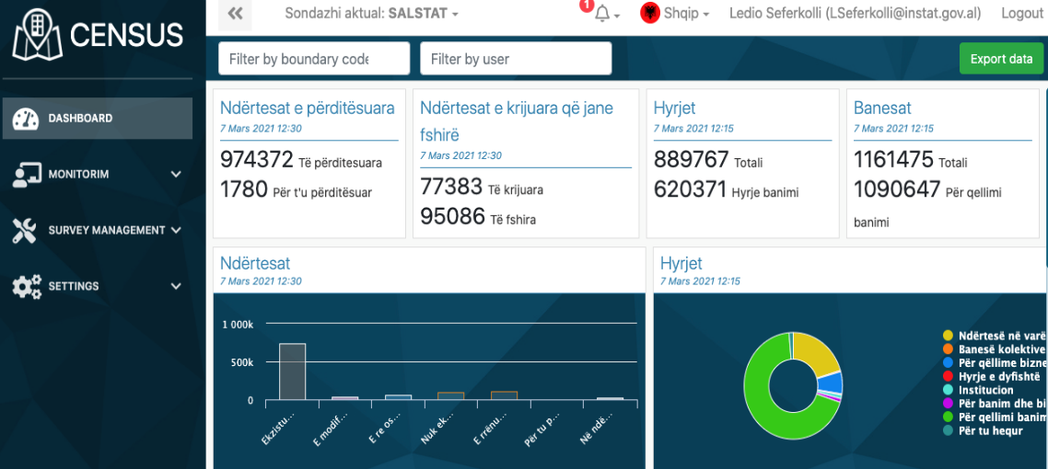
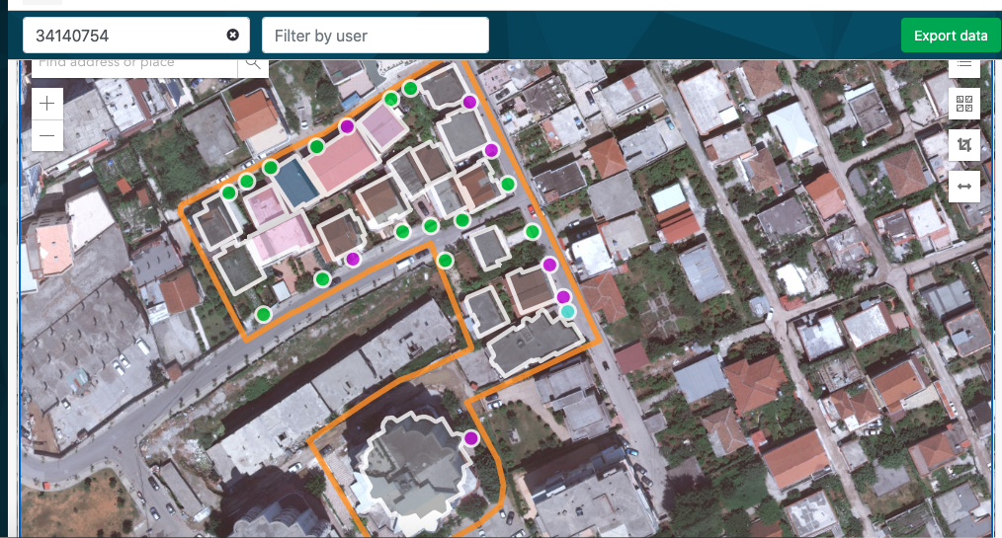
Data collection map application
Notes:
As mentioned above, the collection of geospatial data was performed through tablets with all possible validity rules, quality controls and changes that occurred in the field, data synchronization was performed in real time in the INSTAT geodatabase. There were also methodological improvements in data collection. So far, INSTAT has collected information about buildings and dwellings as a whole. The concept of entrance has been introduced in the 2019 update. Surveyors collect information about buildings and entrances, focusing on entrances where their use is for residential purposes. The application is easy to use in field for data collection, enabling surveyors to draw and modify buildings according to the real shape in field; for planning, monitoring and supporting real-time field surveyors, INSTAT developed a dashboard system. This application in fact is not built only for CENSUS purposes, but will also be used for other INSTAT statistical activities.

Slide 13
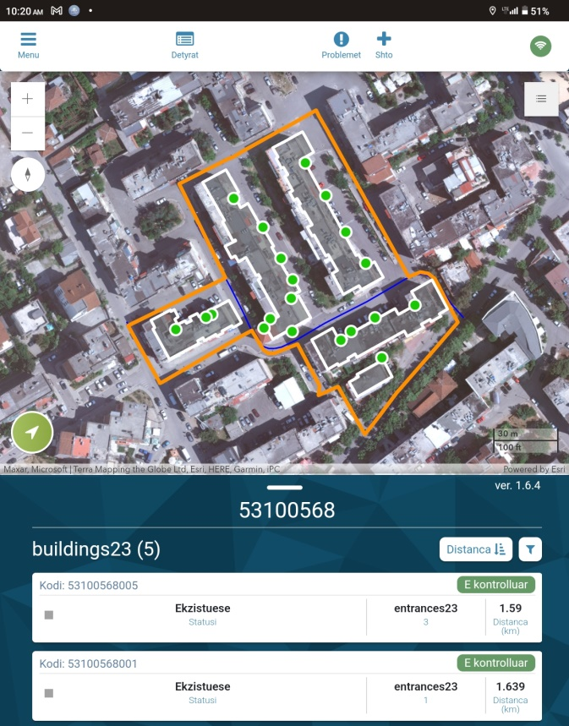
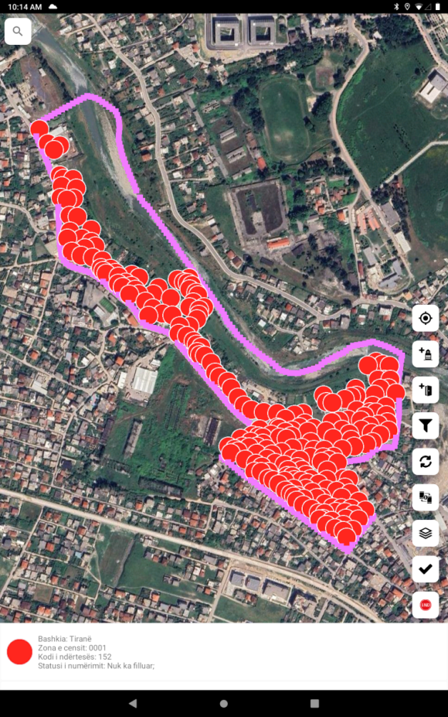
Pre-Enumeration
Updating buildings and housing
Division of areas
census, comptroller,
superintendents

Slide 14
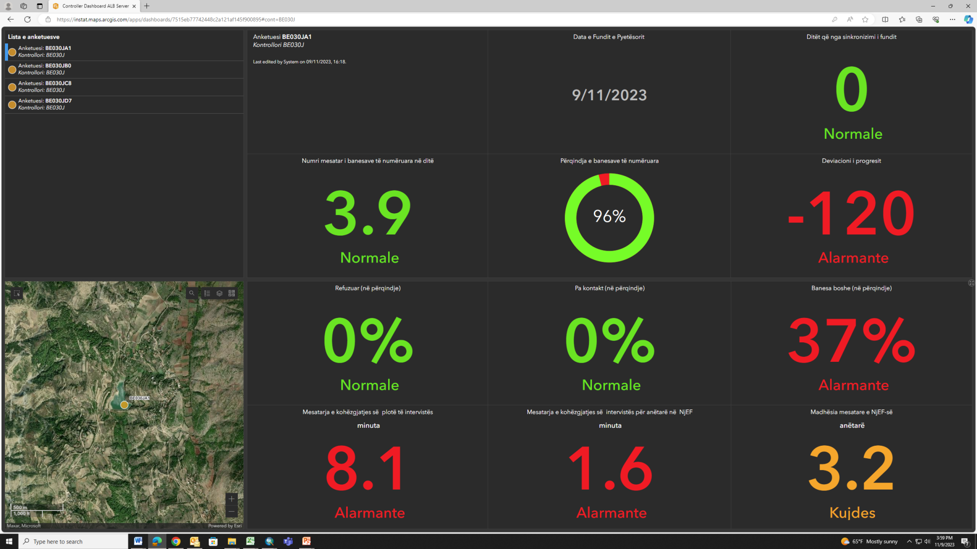
Enumeration
Monitoring of work progress
a) coverage indicators, b) quality indicators;

Slide 15
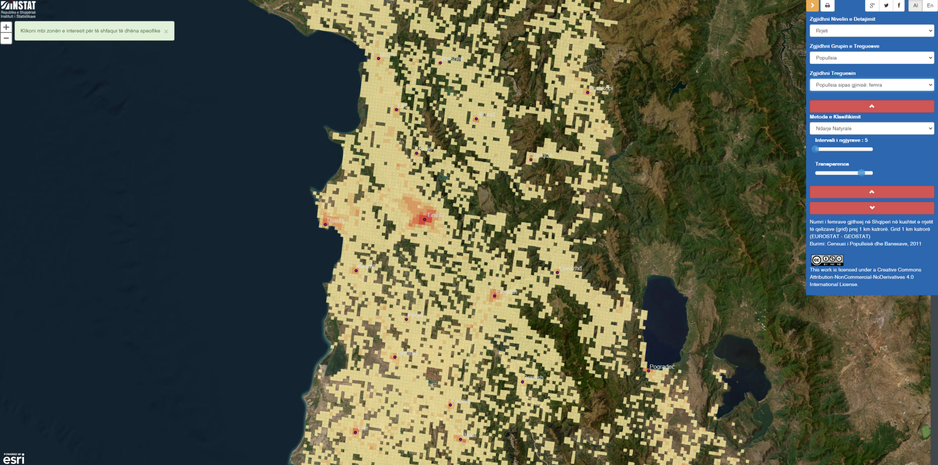
Post-Enumeration
Special publications (maps, atlases, special publications, in-depth analyses)
Geoportal of INSTAT https://instatgis.gov.al

Slide 16
THANK YOU!

