Slide 1
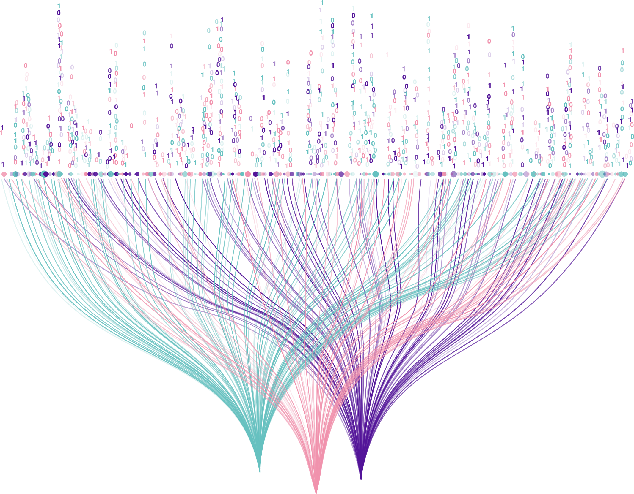
Optimization of official statistics through the use of administrative and private data sources experience of Estonia
Terje Trasberg
Team Lead @ Population and Education statistics team
Statistics Estonia
TAIEX Workshop on modern official statistics in the context
of the EU accession process
20 - 21 February 2024

Slide 2
Some population statistics about Estonia
eesti_statistika
Statistikaamet

Slide 3
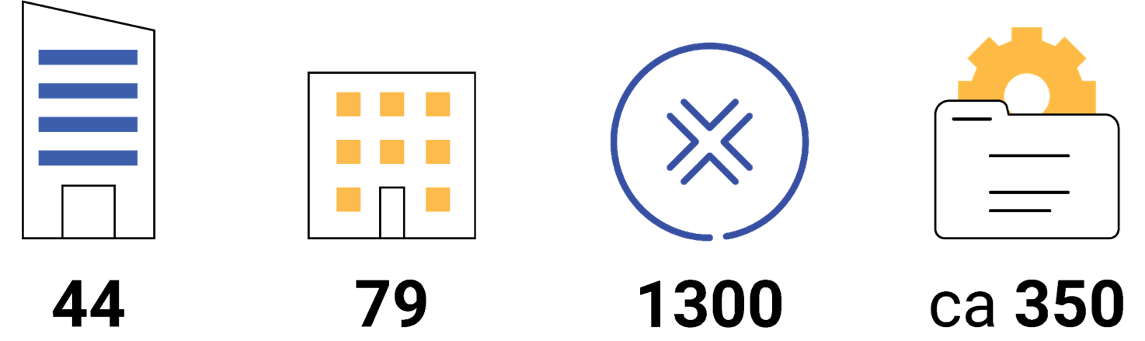
Cornerstones of register-based statistics: availability of data sources
Government agencies
Local government units (15 cities and
64 municipalities)
X-tee services, a data exchange layer
datasets
services:
see: https://www.eesti.ee/en and https://www.riha.ee/ for more information

Slide 4
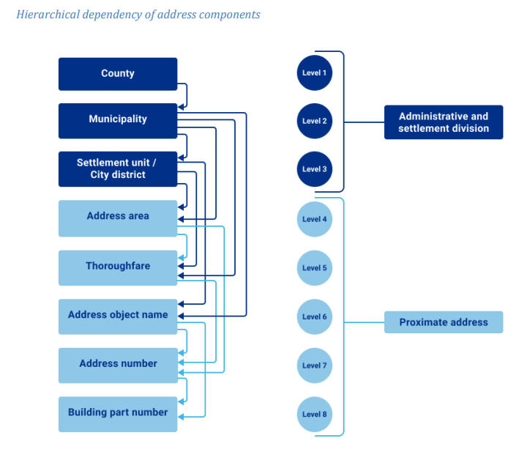
Cornerstones of register-based statistics: linking data from different data sources
A personal identification code is a number with 11 digits formed on the basis of the sex and date of birth of a person which allows the specific identification of the person; in use since 1989
All address data are managed in the Address Data System (ADS). ADS contains about 2.4 million address objects, including approximately 1.1 million buildings, 0.6 million apartments and 0.7 million cadastral parcels. Managed by Estonian Land Board; in use since 2014

Slide 5
Cornerstones of register-based statistics: access to data
Official Statistics Act
Infrastructure for data transfer
Safe data storing infrastructure

Slide 6
From traditional census to register-based census

Slide 7
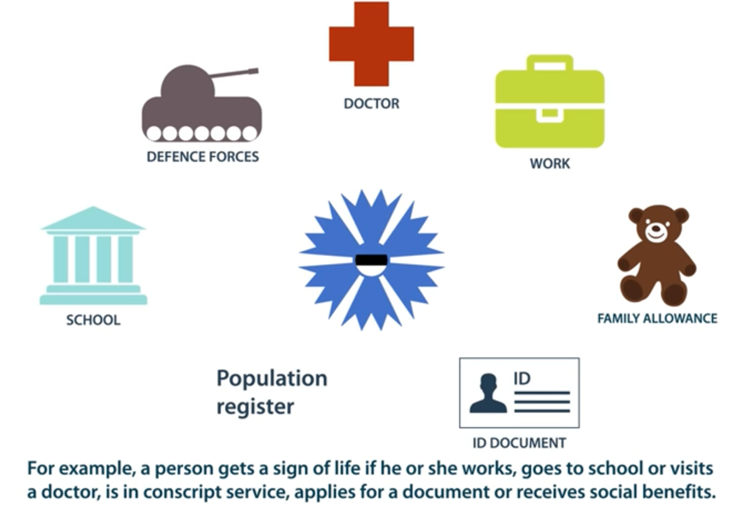
18 administrative registers are used to determine residential population
Signs of life approach: It can be assumed that the people who actually live in Estonia appear in various administrative registers because they are using services and receive payments.
Methodology: https://www.stat.ee/sites/default/files/2021-01/
Implementation%20of%20the%20residency%20index%20in%20demographic%20statistics.pdf

Slide 8
18 administrative registers are used to determine residential population
Signs of life = activity in registers –
Estonian Population Register (marriages, divorces)
Estonian Education Information System (students, teachers)
Social Services and Benefits Registry
Health Insurance Information Database
National Defence Obligation Register
Estonian National Pension Insurance Register
Estonian Unemployment Information System
Register of Residence and Work Permits
E-file system (crime documents, court documents etc)
Estonian Traffic Register (changes of driver’s licenses, changes of vehicles)
Register of Employment
Register of Identity Documents
Estonian Medical Prescription Center
The State Human Resources Database
…

Slide 9
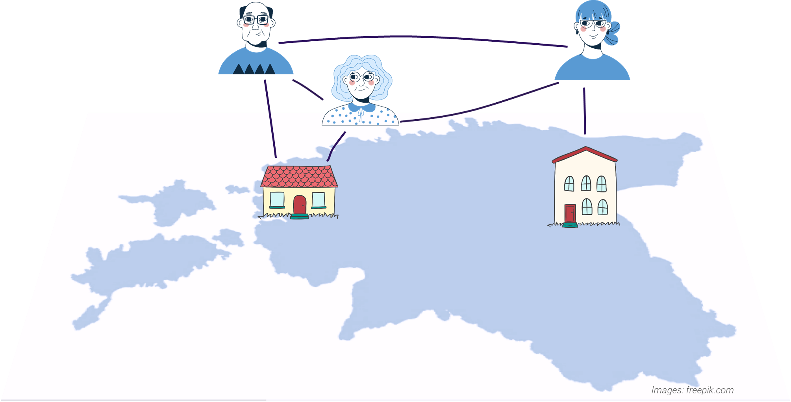
16 administrative registers are used to determine place of residence and households
Problem: 20% of people don't have the correct home address in population register (school/kindergarten places, free services, to support local community). To conduct address-based household statistics for population census a graph-based methodology was developed. It works by looking for person-to-person links and then person-to-place links.
Methodology: https://www.stat.ee/sites/default/files/2022-05/Households%20and%20residences%20in%20registers.pdf

Slide 10
16 administrative registers are used to determine place of residence and households
24 person-person signs: marriage, divorce, parenthood, family allowance, owners/users of a vehicle, buying prescription medicine, care leave, custody, alimony, co-applying for mortgage, tax benefits…
23 person-place signs: place of residence and postal address from different sources, property, mortgage, electricity contract, school, kindergarten, workplace, GP, medical care, dental care, pharmacy…
2 surveys
Estonian Social Survey (EU-SILC)
Estonian Labor Force Survey (ELFS)

Slide 11
Challenges and opportunities
Once-only principle
Some surveys can be partially or totally replaced by
using already existing administrative and/or privately held data sources
Monitoring the quality of the administrative data sources
The quality of statistics is dependent on the quality of the input data
Statistical modelling is often required to adjust for the quality
Some required variables are not present in any data sources

Slide 12
Our vision and mission
We serve as the reliable
home of national data
and give meaning
and value to data.
We help people
understand the world
better through data.

Slide 13
Thank you! Terje Trasberg, PhD terje.trasberg@stat.ee
STATISTICS ESTONIA
www.stat.ee
eesti_statistika
Statistikaamet

