Slide 1
Recent developments and priorities of the European Statistical System in view of modernizing statistical production
Workshop ‘Modern official statistics in the EU accession context’
20-21 February 2024, Chisinau
Jean – Pierre Poncelet
Director, Eurostat

Slide 2
Main developments in modernisation
1. Revision of Regulation 223/2009
2. Developments in quality
3. Use of new data sources
4. ESS Innovation agenda

Slide 3
1. Revision of Regulation 223/2009

Slide 4
Revision of Regulation 223/2009
Objectives
Make the legal framework governing European statistics fit for the future, including enabling new roles of NSIs in the national data ecosystem
Allow statistical authorities to tap into the full potential of digital data sources and technologies, including access to privately held data
Making the framework more efficient and responsive to crises

Slide 5
Revision of Regulation 223/2009
Milestones
10 July 2023 - Commission proposal to amend Regulation 223/2009
1 February 2024 - Council and Parliament reach provisional agreement
Next steps
Approval by the Council
Formal adoption procedure

Slide 6
2. Developments in quality

Slide 7
2. Developments in quality
Revision of the ESS quality framework in 2016-2019 (ESCoP, ESS QAF)
Assessment of the national statistical systems of ESS members against the revised framework – peer reviews in ESS members 2021-2023
Similar peer reviews for the enlargement countries 2025-2027
Using the results for spreading good practice and innovations, for modernising statistics
Revising the quality framework – in view of new technology developments, new roles of NSIs in the data ecosystem and need for quality frameworks for new data sources (e.g. Privately held data, administrative data)

Slide 8
3. Use of new data sources

Slide 9
Use of New Data Sources
Harnessing new data ecosystems – one of the top priorities in the modernisation of EU official statistics
Defining new roles of NSIs - data stewardship, integration and interoperability
The amendment to EU Regulation 223/2009 - focus on access to privately held data for producers of official statistics

Slide 10
Use of New Data Sources - Example of Short-Term Rentals Project
Airbnb, Booking, Expedia Group and Tripadvisor send data, aggregated at local level, to Eurostat each quarter (and submit metadata)
Capacity and occupancy data, similar to the reporting obligations of accommodation service providers as laid down in the tourism statistics Regulation
Eurostat merges and validates the data and produces:
Output data for various geographical aggregates (EU, Member States, regions, cities)
Merged “raw” files for NSIs for additional validation at national level and national data releases/articles/etc.
NSIs and Eurostat disseminate the data and produce various articles, news releases, etc. based on it.

Slide 11
Short-Term Rentals Project: Governance
A practical example of applying the subsidiarity principle
1950es until now: decentralised approach
Eurostat coordinates harmonisation of statistics in the EU, but fieldwork – including key methodological choices – usually happens decentralised in the Member States. This approach makes maximum use of the skills in the NSIs and of the NSI’s proximity to e.g. national registers or “survey culture” in the country
Platforms project: centralised approach
General consensus by all stakeholders
(Eurostat, NSIs, platforms) that the
optimal approach is a “single entry”,
coordinated effort by Eurostat, in close
cooperation with the NSIs and backed by
a mandate of the NSIs as discussed at
technical level (WG) and strategic level
(ESSC, DGINS workshop in May 2019).
ESS

Slide 12
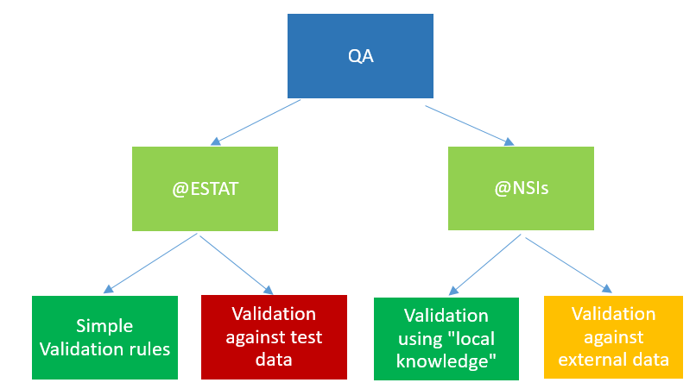
Short-Term Rentals Project: Quality Assurance
Notes:
Two-pillar QA approach: (1) In-house, data is subjected to various consistency checks (such as growth since previous year’s quarter, cross-platform comparisons, etc.), implemented in SAS and Python. We also would like to check against test data, which could be web-scaped, bought, etc., but so far we have not been successful.
(2) Data is sent in advance to the NSIs which (a) are much more knowledgeable about the local markets, and (b) have access to additional data sources. They provide feedback on the data to Eurostat.

Slide 13
Experimental Statistics
Experimental statistics - new data sources and methods to better respond to users' needs in a timely manner
Published statistics on 17 topics, for example: Collaborative economy platforms, Income, consumption, and wealth, Micro high-growth enterprises

Slide 14
4. ESS Innovation agenda

Slide 15
ESS Innovation Agenda - Policy Context
The ESS Vision 2020 Programme ended in 2020 delivering a wide range of results
The recent crisis has proved that innovation is more important than ever in a rapidly changing data ecosystem and to respond to new user needs
A broad consensus on the need to keep a focus on ESS innovation as part of the Multi Annual Plan with a broad scope (product and process innovation)
New measures and new indicator demands …
Health
Inclusive Societies
Security and autonomy
Digital, Industry
Climate, Energy & Mobility
Natural Resources, Agriculture, Environment
Notes:
With the positive conclusion on ESS Vision 2020 programme, there was a broad consensus on the need to keep a focus on ESS innovation as part of the MAP with a large scope (product and process innovation)

Slide 16
ESS innovation agenda
Strategic approach to innovation
Conducting innovative projects
Accelerating and enabling innovation
Reaching out to a larger community of stakeholders active in innovation activities
Operational action plan
Annual rolling plan combining integrating various approaches (quick wins and longer-term capacity building)

Slide 17
ESS Innovation Network (EIN)
Brings together ESS innovation champions to support the innovation execution
Tasks of the EIN include:
Liaison with member states to learn from experiences and good practices
Boost innovation process (new ideas, reuse of capabilities, transition from LAB to FAB)
Initiator of contact with member states, EU organization and external partners
Projects look beyond statistical offices and enable collaboration with external partners / innovation community

Slide 18
Methodological and Technological innovations
Artificial Intelligence and Machine Learning
Privacy enhancing techniques
Quality
ESS innovation cross cutting domains
Cloud
Smart technologies
Geospatial capabilities
Methods for data integration
Notes:
Artificial Intelligence and Machine learning for advanced data processing and supporting complex and resource intensive processes.
Privacy enhancing techniques and organizational aspects for exchange/and reuse of confidential and sensitive data
Use of smart devices and smart technologies for an efficient and resilient data collection.
Advanced methods for data integration and flexible technological environment for producing statistics based on different sources
Advanced techniques and technological frameworks exploiting geospatial capabilities for the integrated dissemination of granular statistics.
Flexible cloud native environment for experimenting, testing and deploying at scale novel technologies and methods and for designing experimental products.
Methods to assess and improve quality

Slide 19
AI/ML One-Stop-Shop for NSIs
A single-entry point for NSIs staff
Sandbox infrastructure to test and pilot AI/ML approaches together with training and coaching
Reference implementation of AI approaches in the production of official statistics (e.g. information extraction, data editing and imputation, automatic coding, use of LLM to support users of statistics)
Communities to share ideas, experiences, success stories and lessons learned to stimulate innovation based on the use of AI/ML.
Best practices to facilitate the transition from development and experimentation of AI/ML-based solutions to industrialisation and production
Time horizon: 2024-2028

Slide 20
Implementing Smart Surveys
Applied research (NSIs, universities) to advance, develop and demonstrate the concept of smart surveys i.e., use of smart devices combining active and interactive data collection
Identify the sharable components of the solutions that could be further developed and used among the NSIs
Identify and promote good practices for privacy and communication methods for engaging respondents.
Time horizon (2023-25)

Slide 21
Privacy Enhancing Techniques
Accelerating the adoption of Privacy Enhancing Technologies (PET) with the ESS as an alternative to direct exchange of personal data between different organisations, lowering privacy and security risks, improving acceptance by data providers and general public.
Build a shared PET infrastructure based on the concept of Multi-Party Secure Private Computing-as-a-Service (MPSPCaaS).
Detailed specification, feasibility analysis, prototyping and demonstration (2025-26) - IT procurement and piloting (2026 onwards)

Slide 22
Innovation mechanisms
Priorities
Peer-to-peer knowledge sharing
Capacity building through training and similar activities
Process design and framework
Communication
Legal Framework
Citizen engagement and citizen science approaches
Economies of scale
CULTURE
Sharing sources
LEADERSHIP
Funding
Partneship & Alliances
Peer to peer knowledge sharing
Legal Framework
Capacity building
Tools / platform
Collab places
ESS enablers

Slide 23
Thank you
© European Union 2023
Unless otherwise noted the reuse of this presentation is authorised under the CC BY 4.0 license. For any use or reproduction of elements that are not owned by the EU, permission may need to be sought directly from the respective right holders.
Slide xx: element concerned, source: e.g. Fotolia.com; Slide xx: element concerned, source: e.g. iStock.com
Notes:
Update/add/delete parts of the copy right notice where appropriate.
More information: https://myintracomm.ec.europa.eu/corp/intellectual-property/Documents/2019_Reuse-guidelines%28CC-BY%29.pdf

