Slide 1

Modern technologies and alternative data sources in Statistics Georgia
GOGITA TODRADZE
Executive Director
National Statistics Office of Georgia (GEOSTAT)

Slide 2





105 years of development
WWW.GEOSTAT.GE
900 employees in 2023
213 permanent staff
80 contracted
600 interviewers
11 Departments
23 divisions
11 Regional offices
63 employees and 4 divisions in 1919
Agricultural statistics
Labour, trade and industry statistics
Transport statistics
Population statistics

Slide 3




Data users in past
Data Users:
Ministries
Court
State council
Other Public institutions
…..

Slide 4

Data users today
International
Organizations
Government
WWW.GEOSTAT.GE
Business Sector
960 thousand visitors of web-site during 2023
Mass media
NGOs
Individuals
Scientific
community
Persons with Disabilities
Kids and Teenagers

Slide 5
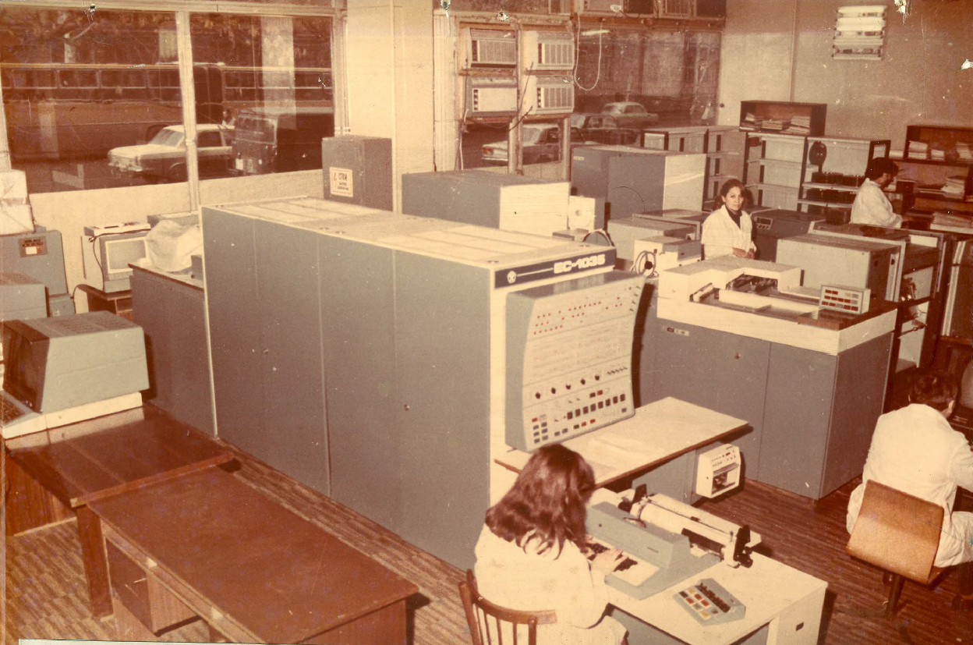

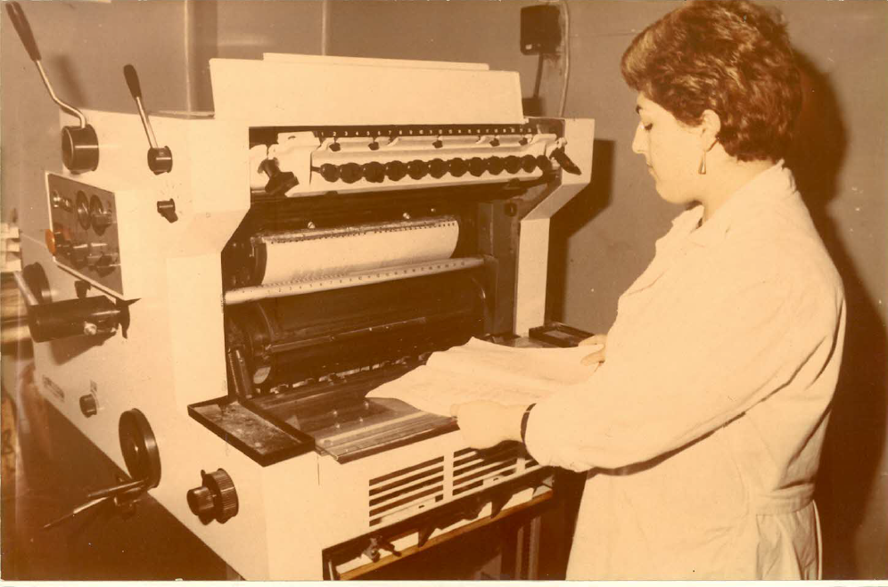

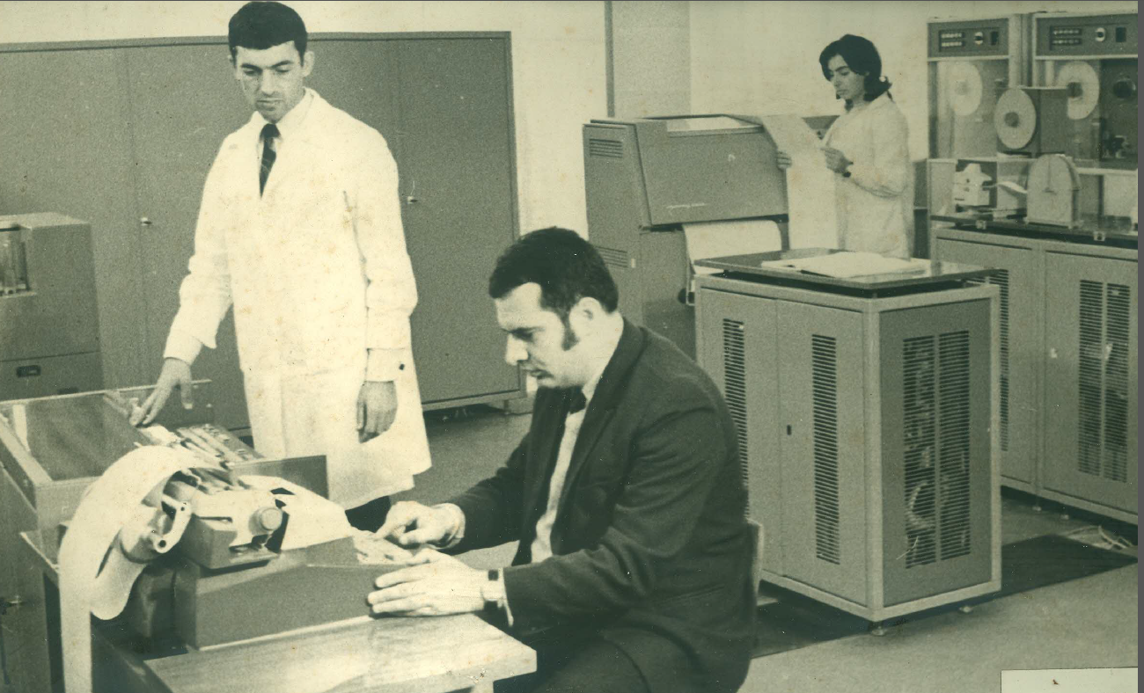

Technologies…
GEOSTAT - “Paperless Office”
1919
…
2024

Slide 6







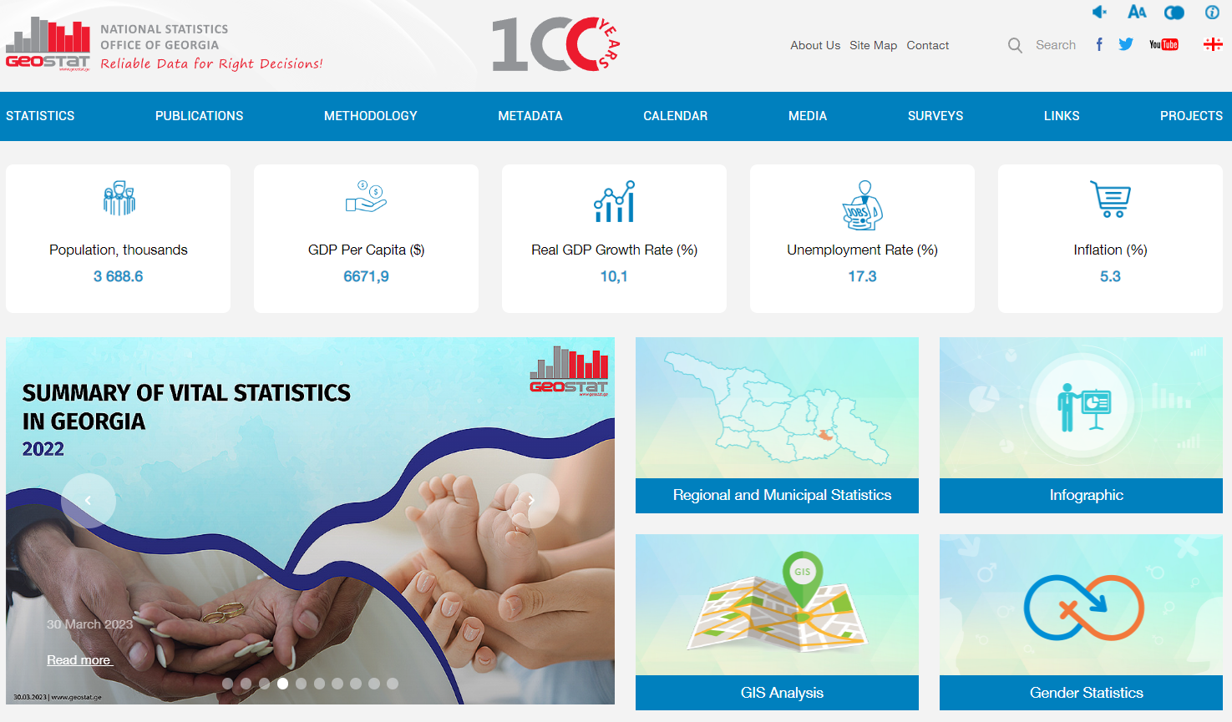

      Data dissemination channels
WWW.GEOSTAT.GE
Adapted for persons with disabilities
Android
&
IOS

Slide 7
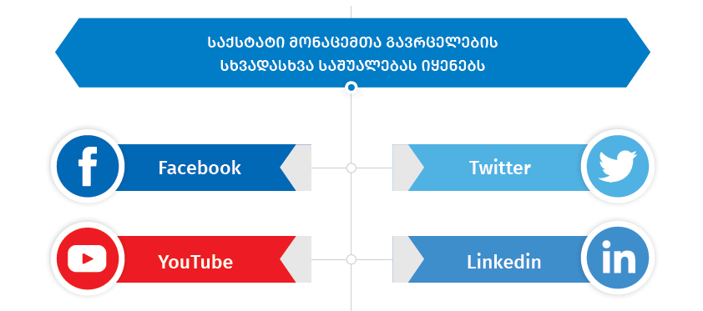

      Thematic Interactive Portals
Data dissemination methods
20 Interactive portals and online calculators

Slide 8




Surveys and administrative sources
Field works- 157 (64%)
Online questionnaire for entreprises / organisations
Face-to-face interviews and CAPI for households
Administrative data - 88 (36%)
  Revenue Service
  National Agency of Public Registry
  Customs Service
  Ministry of Internal Affairs
Administrative sources
Business Statistics
Transport Statistics
Construction Statistics
Demographic Statistics
FDI
Statistics
Education
Statistics
External Trade Statistics
Energy
Statistics

Slide 9

Legislative basis
Basis for preparation of the new LOS
New Law on “Official Statistics”
adopted in 2023
EU Association agreement, (articles 286-291)

Slide 10


Alternative sources and non-traditional methods
Use more and more administrative data sources
Establish modern system for data collection
Looking for new alternative data sources

Slide 11



Activities related to the Big Data solutions
Membership
Georgia is a Member of the Global Working Group on Big Data for Official Statistics, created by the UNSC
Georgia is a Member of the UN Expert Group on Migration statistics
Measuring human mobility with the use of Mobile Phone Data (MPD) will make it possible to:
Estimate population by age and sex at the municipality level;
Internal migration – available annually;
Estimate different forms of migration in real time.
Domestic tourism
Challenges:
Access to the data
Insufficient recourses

Slide 12

Use of alternative data source in Price Statistics
Scanner Data in CPI
Activities started with negotiation between Geostat and retailers, 2019.
In 2020, 2 supermarket chains agreed to provide data on a monthly basis.
SD was obtained for food, beverages and some hygienic products, for 6 major cities
Technical assistant from IMF, starting from 2021
SD for International Comparison Program,2021
SD for update of consumer basket, 2023
Challenges:
Access to the data, Stability, periodicity
Lack of communication

Slide 13
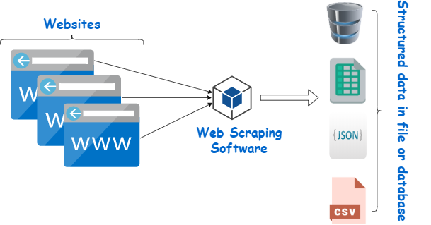
Use of alternative data source in Price Statistics
Web scraping for price statistics
Activities started in 2018 with the aim to develop RPPI
Currently web scraping is the only method of data collection for this index
From Google Chrome extension to R software.
Technical assistant from IMF, starting from 2021
Web scraping is increasingly used also for CPI
Challenges:
Structure of websites
Lack of personnel Skills

Slide 14







New Strategy of NSS of Georgia
1
2
3
Improving data quality
Increase trust and credibility
Facilitating the use of data

Slide 15

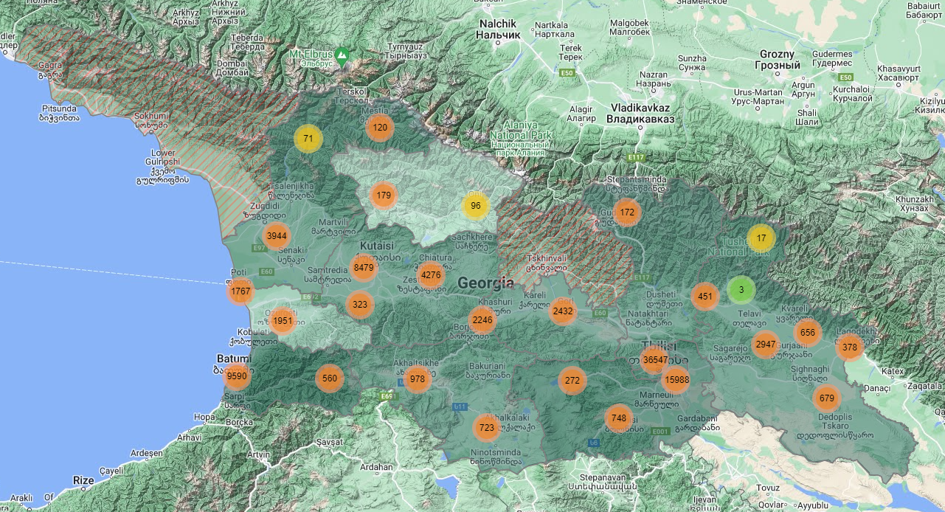


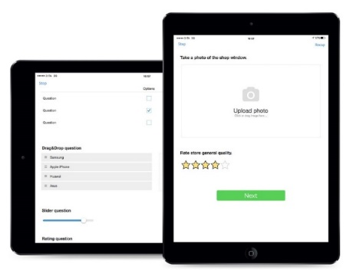

Ongoing Activities
Upcoming EU
Twinning project
Population and Agricultural census 2024
Time for the census:
November 14- December 19, 2024
1. Convergence of existing methodologies and standards with EU requirements
- Modernization of statistical processes in line with GSBPM
  - Implementation of the EU NUTS classification system
  2. Development of demographic and population statistics
3. Strengthening the capacity of the state institution for production and use of statistics

Slide 16



Technologies to collect upcoming census data
Time for the census:
November 14- December 19, 2024

Slide 17
THANK YOU FOR YOUR ATTENTION!
GOGITA TODRADZE
Executive Director
National Statistics Office of Georgia
Reliable Data for Right Decisions!
gtodradze@geostat.ge
WWW.GEOSTAT.GE

