Slide 1
Innovation in statistics as a key element in modernizing official statistics
- experience of Poland
Session 3. Best way forward to modernization
of official statistics
Małgorzata Pietrzyk, Jarosław Kalski
Statistics Poland

Slide 2
Main points
Experience of Polish official statistics in obtaining funds for development over the years
Examples of innovative actions implemented by Statistics Poland

Slide 3
Polish accession proccess to the EU
EU's biggest enlargement:
1 May 2004
10 countries have joined the EU, including Poland
Almost 20 years experiences in cooperation within the EU structures

Slide 4
Why to modernize the statistics?
Statistics: a tool for monitoring economic development and social changes for economic decision-making and policy-making
Therefore, the process of European integration has also included this area
The essence of integration in statistics: surveys methodologies that ensure comparable results on a European scale

Slide 5
Harmonization of Polish statistics with the EU statistics in the pre-accession period
Financing from pre-accession funds for the implementation of pilot projects and surveys, participation in Eurostat working groups and the development of IT infrastructure
Support for Statistics Poland in the framework of twinning projects financed by PHARE funds:
Regional Statistics - France (2001-2003),
Statistical Information System - Germany (2002-2004),
Improving the quality of Polish statistics
- Sweden (2004-2006)

Slide 6
Pros and cons of membership in the European Statistical System
Legal and organisational adaptations
Legal unification - comparability of statistics across the EU (common standards, methodology)
Institutional independence strengthened
Real influence on the development of the ESS
Continuous keeping process of checking the quality of our surveys/peer reviews
Development opportunities – grants
Financial benefits
Exchange of experience and know-how, building competences - capacity building
One strong statistical voice on international arena – better visibility
OPPORTUNITIES

Slide 7
Pros and cons of membership in the European Statistical System
Financial costs
Necessity to involve more human resources (units dedicated to cooperation with EU bodies and coordination of the legislative process within the country)
Optimisation of the organisation's activities
New obligations - compliance with EU law, need to implement new surveys/adaptation of standards
Subject to continuous external monitoring (Eurostat, peer review, etc.)
Readiness to develop/innovate
CHALLENGES

Slide 8
ESS is also about…
Establishing international cooperation on statistics (projects):
both developing ESS statistical system and
partner countries’ statistical system (e.g. PAS)
Organising internships within EU funds
Conducting international events for statistics family
Building a positive image of official statistics on the international arena

Slide 9
Acquiring foreign funds for developing and strengthening the official statistics
SINGLE MARKET PROGRAMME (SMP) 2021-2027
EU grants
Improving the quality of official statistics, constant modernization and adjustment of Polish statistics to ESS standards and new innovative activities
Implement innovative solutions/methods
Building the international partnerships
Impact on the development of the ESS, exchange of experiences, know-how and share good practices, avoid duplication of work, economizing resources (MBGA projects)
Develops not only substantive-matters competence but also ability to cooperate in diverse cultural environments, language skills - development of competences and capacities of institutions
Other foreign sources (e.g. Korean funds)

Slide 10
Maturity of Statistics Poland – the role of donor of support
INSTITUTIONAL SUPPORT
EXPERT SUPPORT

Slide 11
Innovative activities
Development projects
- new data sources
- cooperation
- new dissemination methods
Institutional development
- implementation of modern technologies
- improvement of competence

Slide 12
Development projects
New data sources
administrative data
Cooperation
national: with science, ministries, local government, private sector
New dissemination methods
with users for users
satellite data
web-scraped data
…
constant analysis of users' information needs
projects in international consortium, grants

Slide 13
New data sources in official statistics
OPPORTUNITIES
New information in many socio-economic phenomena
More granular data
More timely data (including real-time analysis)
Reduction of the burden on respondents
Reduction of research costs
Response to the growing users needs
CHALLENGES
Stable access to new data sources (including privately-held data)
Quality
Integration in official production
Architecture and IT infrastructure
Privacy enhancing techniques
Relevant staff competencies and organizational capabilities

Slide 14
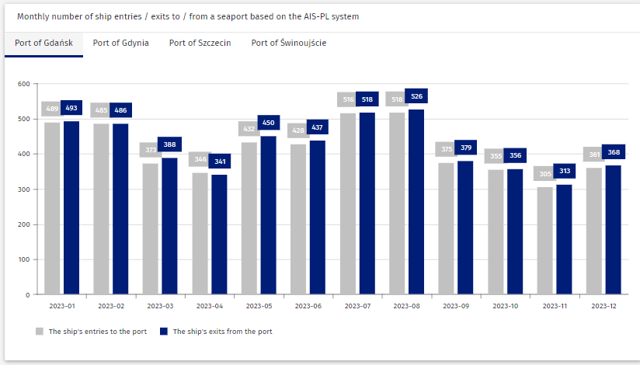
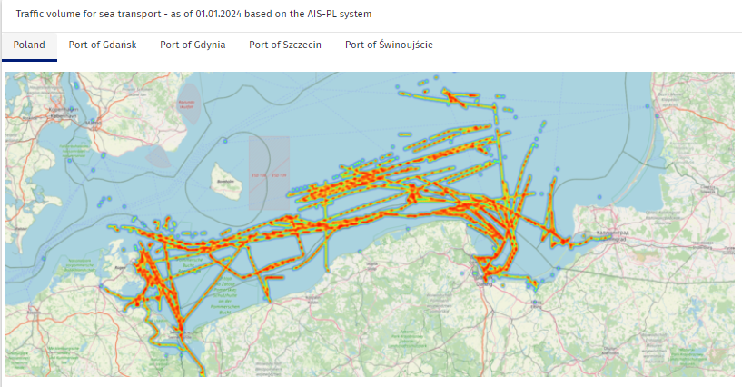
Examples

Slide 15
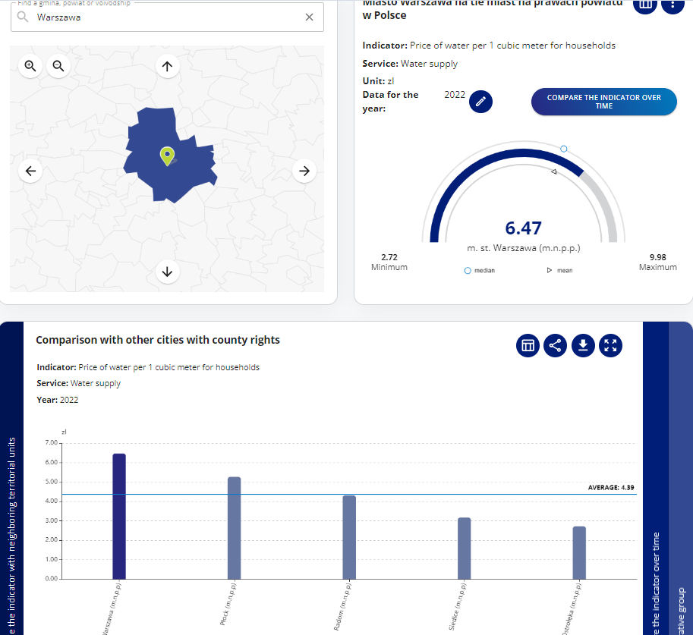
Example – Public Services Monitoring System
A product dedicated to local government
Consortium: The Ministry of the Interior and Administration, Statistics Poland, Association of Polish Cities, Association of Polish Counties
Optimisation of the process of providing public services based on monitoring data

Slide 16
Institutional development: investments in human resources
Increasing the use of non-statistical data sources in the statistical production of official statistics
Increasing the knowledge and competences of employees in the area of Data Science
Building a community of people with passion, strengthening cooperation over the hierarchical organizational structure, exchange of knowledge and experience
Constantly looking for people with potential who will strengthen the Data Science community in the field of non-standard production, but also support it with an innovative look

Slide 17
Data Science Academy ecosystem
Admissions to the Academy
Individual development paths
f(x)
Data Scientist
Data engineer
Clearly defined inclusion criteria
Data analyst
Acquiring, developing and retaining employees
Implementing improvements
Building a data science community

Slide 18
Some latest developments
https://transtat.stat.gov.pl/Default.aspx Road and maritime transport statistics
https://smup.gov.pl/ Public Services Monitoring System
https://sdg.gov.pl/en/ Statistics for the SDGs – global indicators for Poland
https://svs.stat.gov.pl/ Statistical Vademecum for Local Government
https://stat.gov.pl/en/experimental-statistics/ Experimental Statistics
…
… and more on https://stat.gov.pl/en/

Slide 19
Thank you
Małgorzata Pietrzyk
Head of Unit in International Relations and Statistical Cooperation Department
Jarosław Kalski
Head of Unit in Department for Innovations
Contact:
malgorzata.pietrzyk@stat.gov.pl
j.kalski@stat.gov.pl

