Slide 1
Recent developments and priorities regarding the modernization of official statistics in Ukraine
20-21 February 2024, Chisinau, the Republic of Moldova
Nataliia Pavlenko - Deputy Director, Department for Planning, Development and International Cooperation,
State Statistics Service of Ukraine

Slide 2
S T A T E S T A T I S T I C S S E R V I C E OF U K R A I N E
Association Agreement between the European Union and the European Atomic Energy Community and their Member States, of the one part, and Ukraine, of the other part
(since September 16, 2014 No. 1678-VII).
On June 23, 2023, the European Parliament adopted a resolution granting Ukraine the status of a candidate for membership in the European Union.
On January 1, 2023, the Law of Ukraine "On Official Statistics" dated August 16, 2022 by No. 2524-IX came into force (it was prepared based on the Generic Law on Official Statistics developed as part of the United Nations Development Accounts Project in April 2016 for the countries of Eastern Europe, the Caucasus and Central Asia).
Purpose of the Law
harmonization of the state statistics with the statistical system of the European Union
creation of conditions for the activities of the national statistical system authorities in line with the generally accepted principles of world and European statistical practice.
2

Slide 3
S T A T E S T A T I S T I C S S E R V I C E OF U K R A I N E
The main changes in the legislation that have been
implemented by the Law of Ukraine «On Official Statistics»
The concept of «Official statistics» was introduced (Article 1).
Adherence to the principles of the European Statistics Code
of Practice Fixed at the statutory level of by all members
of the national statistical system is fixed at the
legislation level (Article 5).
It envisages the following:
the right of state statistics authorities to get free access to available administrative data (Article 8);
provision of reporting by respondents exclusively in electronic form (Article 10);
conduct of the experimental state statistical observations (Article 12);
coordination of the state statistical activity by the State Statistics Service of Ukraine (hereinafter referred to as SSSU) (Article 21);
setting up the National Council on Statistics (Article 20). The Regulation on the National Council on Statistics was approved by resolution No. 1039 of the Cabinet of Ministers dated September 29, 2023;
harmonization of activities of state statistics authorities and other official statistics producers on issues related to statistical confidentiality (Articles 29-32).
3

Slide 4
S T A T E S T A T I S T I C S S E R V I C E OF U K R A I N E
The main task of state statistics authorities is to provide the state and society with comprehensive and impartial statistical information.
The program to develop the official statistics till 2028 was approved by Resolution No. 989 of the Cabinet of Ministers of Ukraine dated September 15, 2023.
Priority areas of development are as follows:
Harmonization of the national statistical system with international and European norms and standards;
Digital transformation;
Openness and availability of information.
Each year, SSSU makes the Inventory (review and analysis) of the state statistical observations during which the issues related to conformity of the methodology for compiling data of state statistical observations with the legal acts of the European Union are considered.
Since the beginning of 2023, SSSU has started preparing quality reports taking into account the European SIMS standard and administrative data quality reports.​
4

Slide 5
S T A T E S T A T I S T I C S S E R V I C E OF U K R A I N E
SSSU Transformation Activities
launch of a new technological platform for SIGMA statistical production with the integration of the process of information processing and its dissemination using cloud technologies
implementation of the state statistical observations on the new SIGMA technological platform
digitization of information exchange with administrators of administrative data
harmonization of the list of output indicators of the state statistical observations with the EU standards
launch of "Management statistics" products with the functionality of interactive dashboards
launch of a new website (portal of official statistics) and migration of historical statistical information
5

Slide 6
S T A T E S T A T I S T I C S S E R V I C E OF U K R A I N E
The primary assessment of the implementation status of EU legal acts was made in accordance with the mandate of the Cabinet of Ministers of Ukraine dated March 14, by 2023 No. 7639/0/1-23 and in accordance with the requirements of the Resolution of the Cabinet of Ministers of Ukraine dated February 28, 2023 by No. 189 «On Approval of the Procedure for Conducting the Primary Assessment of implementation status of EU legal acts».
SSSU, together with other government authorities carried out the work on preparing and responding to the European Commission questions for the «Individual Annual Report» under the preparation of the 2023 Enlargement Package.
The work was carried out in two stages:
until June 30, 2023 – filling in the electronic tables of the primary assessment of the implementation status of EU legal acts;
by 30.08.2023 – preparation and submission to the Cabinet of Ministers of Ukraine of the report based on the results of the assessment along with the proposals for bringing Ukraine's sectoral legislation into compliance with EU legal acts.
6

Slide 7
S T A T E S T A T I S T I C S S E R V I C E OF U K R A I N E
In 2023, for the first time, Ukraine took part in the monitoring round of compliance with the statistical acquis of the European Union for candidate countries and potential candidates (annually conducted with the use of the Metadata Processing Tool of the European Statistical System on the EDAMIS platform, which allows collecting, verifying and disseminating the national and European reports in accordance with the ESS metadata standards).
SSSU, together with other members of the national statistical system, made a self-assessment in 92 thematic areas.
In August 2023, SSSU received the Monitoring Report prepared by Eurostat's technical units.
The monitoring report is important for understanding the current status of compliance with EU legislation, identifying activity areas where efforts are needed.
7

Slide 8
S T A T E S T A T I S T I C S S E R V I C E OF U K R A I N E
Pursuant to the resolution of the Cabinet of Ministers of Ukraine «On approval of the Procedure for conducting primary assessment of the implementation status of the acts of the European Union», SSSU, together with other state authorities, participated in the evaluation of the Ukraine’s legislation regarding its compliance with the European Union acts.
SSSU was identified as responsible for negotiating chapter 18 «Statistics».
In August 2023, SSSU prepared and submitted to the Cabinet of Ministers of Ukraine a report on the results of the assessment along with proposals for bringing Ukrainian legislation in the field of statistics into compliance with the EU legal acts.
The proposals received as a result of the evaluation became the basis for the formation of the National action plan for the implementation of the European Commission recommendations presented in Ukraine’s Progress Report under enlargement package on the implementation of the European Commission recommendations in 2023 (Chapter 18 «Statistics»):
strengthening the institutional independence and administrative capacity of SSSU and coordination between relevant authorities in order to improve the statistical data quality;
increase in production and timely transfer of quality data to Eurostat.
8

Slide 9
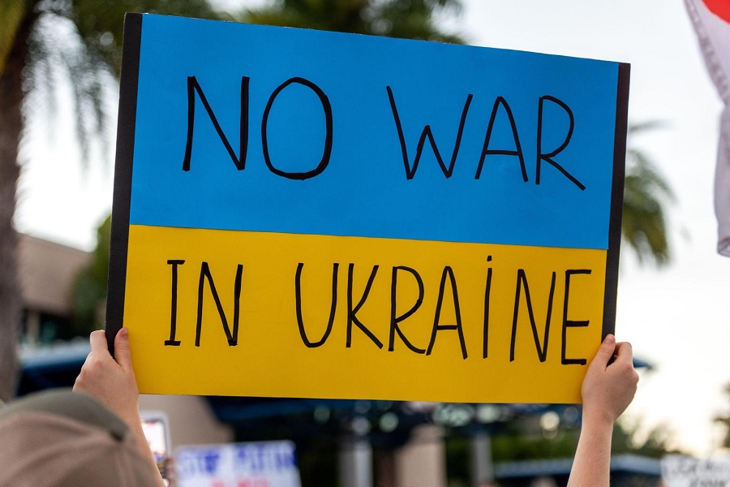
S T A T E S T A T I S T I C S S E R V I C E OF U K R A I N E
The Law of Ukraine «On the Protection of the Interests of Entities that Submit Reporting and Other Documents During the Period of Martial Law or a State of War» (since March 3, 2022 by No. 2115-IX) provides for that during the period of martial law or a state of war, as well as within three months after its completion, the administrative responsibility for non-submission or late submission of reports will not be applied to respondents.
Many respondents exercised this right which made it impossible to compile statistical data on the most state statistical observations.
In order to carry out the work provided for by the plan for the state statistical observations and to increase data production and their transfer to Eurostat, a draft Law on Amendments to the Current Legislation has been prepared and submitted to the Cabinet of Ministers of Ukraine according to which respondents will be required to submit reports to the state statistics authorities during the period of martial law.
9

Slide 10
S T A T E S T A T I S T I C S S E R V I C E OF U K R A I N E
THANK YOU FOR YOUR ATTENTION
10

