Slide 1
Workshop on Modern official statistics in the EU accession context
The population data produced using administrative data sources: Experience of Türkiye
TURKISH STATISTICAL INSTITUTE (TurkStat)
Demographic Statistics Department
21-22 February 2024, Chisinau

Slide 2
Background
Annual register based population statistics since 2007
2002
Central Civil Registration System (MERNIS)
2006
National Address Database
(NAD)
2007
Address Based Population Registration System (ABPRS)
1927
First Traditional Census
2000
Last Traditional Census
2011
First Combined Census
2021
Second Combined Census

Slide 3
Traditional Censuses of Türkiye

Slide 4
Traditional Censuses
History
The first census in 1927,
The second census in 1935,
Every five years between 1935-1990,
The last census in 2000
Totally 14 traditional population censuses.
Method
Traditional census method (face to face interview),
Standard questionnaire,
De facto population definition,
One day application with national curfew.

Slide 5
Traditional Censuses
Problems
One day application with national curfew
No information on usual residence (de jure),
Over-counting population,
Need for too many enumerators (2000 PHC 1 million)
High cost,
Limited number of questions included in the census questionnaires because of the one-day application,
Very long duration of data processing (around 3.5 years),
Outdated information

Slide 6
Administrative Data Sources for Population Statistics

Slide 7
Administrative Data Sources for Population Statistics
The Central Civil Registration System (MERNIS)
… centrally administered system established in 2002.
Any changes in civil status (births, deaths, marriages etc.) are registered electronically
in real time
over a network
by the civil registration offices
… based on family ledgers.
… has become the backbone of the e-Government infrastructure in Türkiye.
Information on place of usual residence is not available.
Maintenance of the system -> Ministry of Interior.
Vital statistics are also produced from this database.

Slide 8
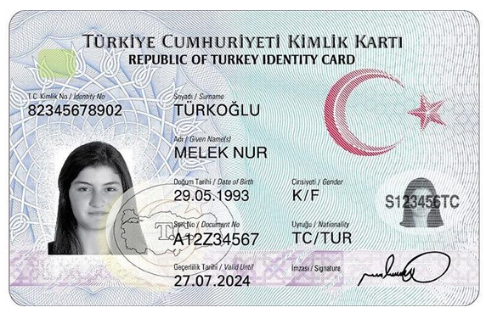
Administrative Data Sources for Population Statistics
TR Identity Number
Unique ID number in MERNIS
assigned to all Turkish Citizens
comprised of 11 digits
(which do not contain personal information)
Used nationwide by all government agencies in public services
… provides:
Registering all vital events occurred from the moment of birth,
More quickly and well-directed public services,
Fast and efficient identification,
Linkage between population registers and other personal information.
* The identity is fictional.

Slide 9
Administrative Data Sources for Population Statistics
Vital Statistics
Data sources:
The Ministry of Interior, General Directorate of Civil Registration and Citizenship Affairs, Central Civil Registration System (MERNIS)
Turkish National Police, Gendarmerie General Command, the Ministry of Justice, General Directorate of Prisons and Detention Houses, Turkish General Staff and TurkStat Causes of Death Data.
Time coverage:
Birth statistics 2001 and onwards
Death statistics 2009 and onwards
Marriage statistics 2003 and onwards
Divorce statistics 2003 and onwards
Suicide statistics 2012 and onwards
Coverage: The whole country
Data collection method: Administrative records
Periodicity: Annual

Slide 10
Administrative Data Sources for Population Statistics
National Address Database (NAD) and Address Based Population Registration System (ABPRS)
Legal Base:
Civil Registration Services Law No. 5490, dated 29.04.2006.
Civil Registration Services Law charged;
TurkStat for establishing the ABPRS.
Ministry of Interior for maintaining and updating the system.
The Regulation on Address and Numbering Study.
(Prepared in accordance with Civil Registration Services Law)
The Turkish Statistical Law No. 5429, dated 10.11.2005
(related articles on field application and data confidentiality).

Slide 11
Administrative Data Sources for Population Statistics
National Address Database (NAD)
Established in 2006.
Around 40 million addresses were entered to the system with unique address codes.
Field work were carried out by local administrations (municipalities and others) and infrastructural studies were carried out by TurkStat.
Maintenance of the system -> Ministry of Interior
Updated continuously by the declarations of address changes
Up-to-dateness of address components is ensured by the Ministry
… text based address registers. (No spatial/coordinate information)

Slide 12
Administrative Data Sources for Population Statistics
Address Based Population Registration System (ABPRS)
Established in 2007.
Residence address information of Turkish Republic citizens and foreign nationals residing within the boundaries of the country were collected
After establishment of the system by the TurkStat, the system was transferred to the Ministry of Interior by the end of 2007.
ABPRS is updated by three ways in general:
Updating the components of the addresses in the NAD by municipalities/special province administrations,
Updating the changes in administrative units by the General Directorate of Civil Registration and Nationality,
Updating the usual residence addresses of persons by the civil registration offices.
Population statistics by administrative units are produced annually from the system by the TurkStat since 2007.

Slide 13
Statistics produced from ABPRS
Statistics produced annually (since 31 December 2007) :
Population size by localities
Age, sex
Literacy and completed level of education
Nationality
Marital status
Place of civil registration
Internal migration (2008)
Mean household size (2008)
Place of birth (2014)
Type of households (2016)
Immigration and emigration (2018)
Reasons for internal migration (2019)
ABPRS is also base for:
Life tables
Population projections
Also serves as a sampling frame of household surveys

Slide 14
Combined Censuses

Slide 15
Combined Censuses
Purpose
To obtain information that are not available in the ABPRS and other administrative registers or cannot be obtained from regular household surveys in province level.
Legal base
The Official Statistics Program of TurkStat, and in line with EU Requirements and UN Recommendations

Slide 16
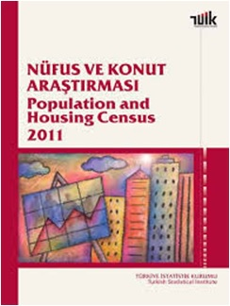
Combined Censuses
2011 Population and Housing Census
De jure population definition
Proportion of register usage: ~20%
Sample survey for households
Full enumeration in institutional places
In total: 2.4 million households and 9 million individuals
Face to face interview
40% PAPI
60% CAPI

Slide 17
Combined Censuses
2021 Population and Housing Census
De jure population definition
Proportion of register usage: ~50%
Population data:
ABPRS (Demography, migration, household)
Labour Force Survey (Labour force statistics)
Housing data:
Survey on Building and Dwelling Characteristics, 2021
306 615 households
4 October 2021 – 1 April 2022
CATI

Slide 18
Combined Censuses
Registers used:
Address Based Population Registration System,
National Address Database,
National Education Statistics Database,
Social Security Records,
Unemployment Agency Records,
Building Permits
For:
Individual level data
Address frame
Ensuring the accuracy
Corrections/Imputations

Slide 19
Cost Of Censuses
Census Year | Method | Cost (According to March 2022)
2000 | Traditional | 33 million Euro
2007 | Establishment of the ABPRS | 27 million Euro
2011 | Combined | 7 million Euro
2008-2021 | Production from the ABPRS | 0 Euro
ABPRS 15 years old.
Alternative perspective:
Cost per year: 1.8 million Euro

Slide 20
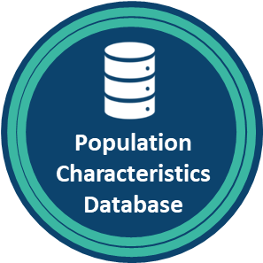
Population Characteristics Database
Population Characteristics Database
Population Characteristics Database (PCDB) project, of which responsibility was given to TurkStat according to the Eleventh National Development Plan, will be used for statistical purposes.
This database can basically be defined as a database established by the integration of ABPRS with a wide variety of other administrative registers. In addition to the population, demography and migration characteristics in ABPRS, PCDB will provide integrated information on the socio-economic characteristics of the individuals living in the country.

Slide 21
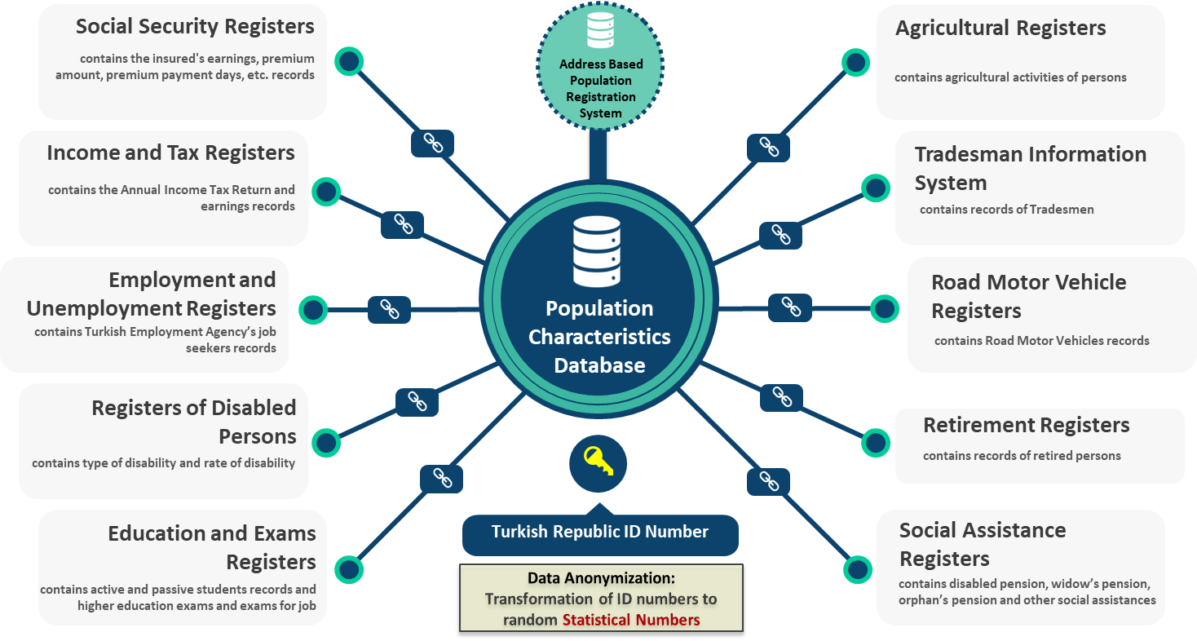
Population Characteristics Database

Slide 22
Thank you for your attention

