Slide 1
National Bureau of Statistics (NBS) in the National Statistical System
Mr. Oleg CARA,
Director General of the National Bureau of Statistics (NBS)
oleg.cara@statistica.gov.md

Slide 2
Table of Contents
Background
NBS role
The activity of the NBS during COVID-19 pandemic
Challenges and opportunities

Slide 3
The role of the NBS (1)
Government agency responsible for official statistics
Provides government bodies, mass media, businesses, academia, population, non-commercial organizations, etc. with statistical information on socio-economic and demographic situation and development of the country
Main producer of official statistics:
SNA (GDP and other agregates)
Business and other economic statistics
Social statistics
Demographic statistics

Slide 4
The role of the NBS (2)
Develops statistical methodology in accordance with international, especially with the EU standards
Conducts:
Population and Housing Census (last – in 2014; next – planned for 2023)
Agricultural Census ((last – in 2011)
Business surveys
Surveys of households (HBS, LFS, etc.)
Compiles offical statistics

Slide 5
The role of the NBS (3)
Disseminates official staistics to national users and international organisations (via website, press-releases, publications, etc.):
Responsible for coordinating the National Statistical System
Scope of the statistics
Quality of the statistics
Availability of the statistics

Slide 6
NBS partners upward and downward information flow:
Other statistical data producers (NBM, MF, ME, etc.)
Data suppliers
statistical data suppliers (respondents),
administrative data suppliers (local and central public authorities), who are often users of statistics as well.
Academic environment, other institutions that contribute to the development of statistical methods & practices
The users of statistics: the official statistics bodes operates to satisfy their needs

Slide 7
The development of the National Statistical System (NSS)
The years 2016–2020 were an important period for the development of NSS. The NBS's efforts have been directed towards the continuous harmonization of national statistics with European and international standards and requirements
National Strategy for the Development of the National Statistical System 2016-2020, approved by Government Decision no. 1451 of 30.12.2016
New Law on Official Statistics (nr 93/2017)
National Action Plan 2017-2019 for the Implementation of the Association Agreement Republic of Moldova - European Union;
The Government Action Plan for the years 2019-2020, approved by Government Decision no. 420 of April 9, 2019.
The Government Action Plan for the years 2020-2023, approved by Government Decision no. 636 of December 12, 2019.

Slide 8
Key figures about NBS’s staff
Number of employees (705):
In HQs: 242
In Territorial Offces (463):
150 interviewers for sample surveys in households: HBS and LFS
Other staff: 313

Slide 9
NBS during COVID pandemic
Teleworking – main type of activity in the NBS Headquarter and territorial offices
Smart working - video and audio conferencing, online meetings, workshops and trainings
Use of new communication channels/tools (e.g. Zoom, TrueConf)

Slide 10
Addressing new data needs: HHs (1)
Dedicated ad-hoc module to HBS on Impact of the COVID19 pandemic on the household (collected since April 2020)
Approach 1 ->
ongoing
1st release – expected by end September

Slide 11
Addressing new data needs: HHs (2)
LFS: targeted follow-up questions to the “reasons for…” (absence, for working more/less hours than usual, for not seeking work, for not being available, for recent job loss), e.g. “ Is this because of the COVID-19 virus?”
Approach 2 ->
ongoing
2 releases done, 3rd expected in December

Slide 12
Addressing new data needs - businesses
CPI data: in addition to monthly data, data on food products are produced twice a month to enable analysis and monitoring of consumer prices for key products
Additional reasons of non-responses
included for treatment of non-responses

Slide 13
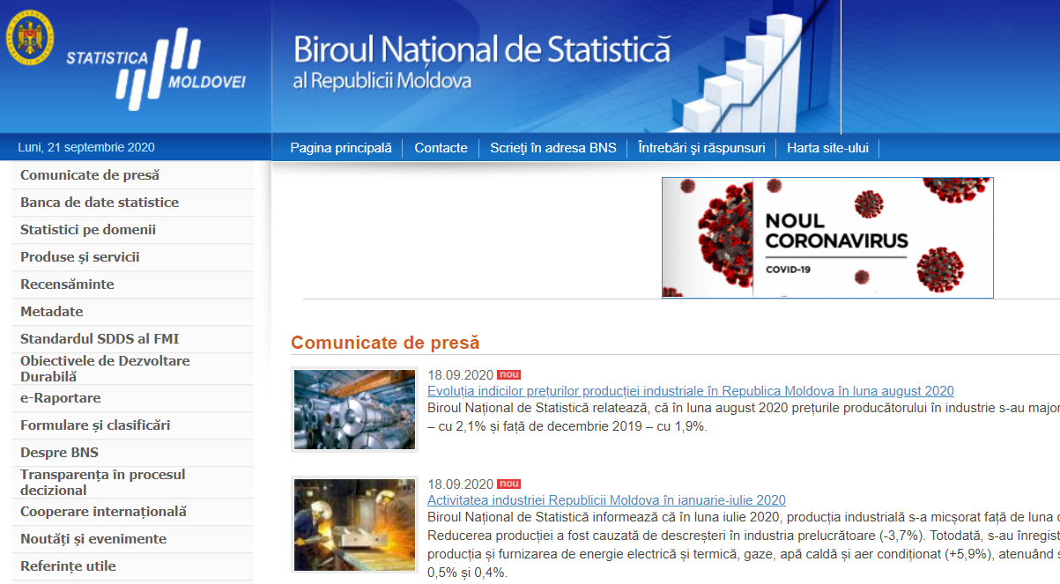
Communication on response to Covid-19
COVID-19 dedicated page (in Romanian, Russian, English) created on the official website www.statistica.gov.md
Any deviation from the dissemination calendar or change in the way or deadline of presentation of data is announced in advance on the official website of the NBS
Changes in the reporting deadlines or in the operation of statistical offices announced
Communication extended via social networks Facebook and Twitter

Slide 14
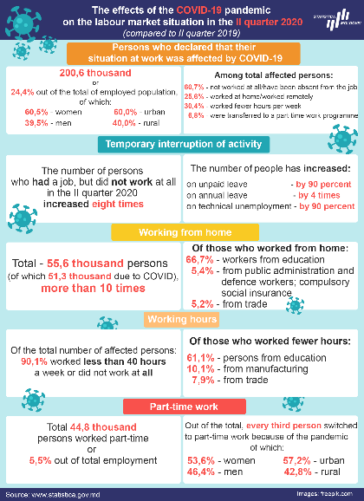
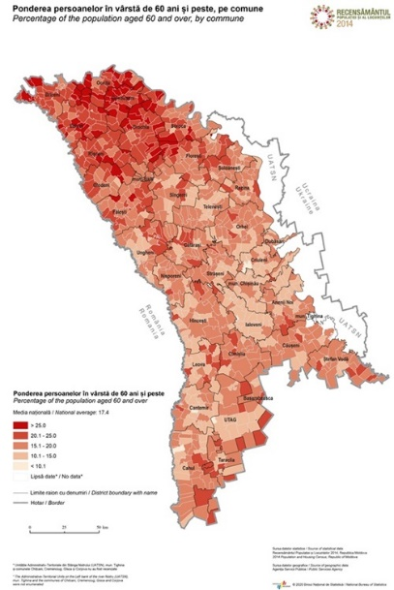
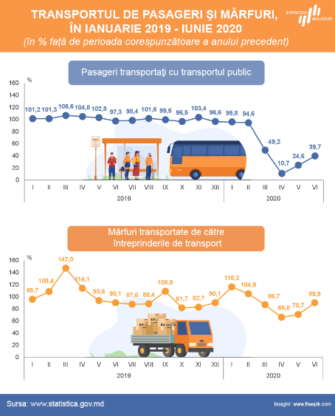
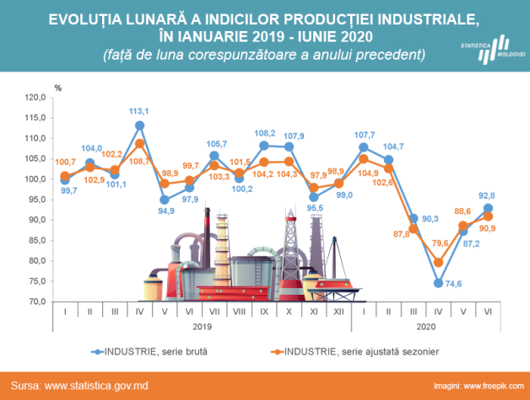
Dissemination during Covid-19
Covid relevant press releases
Infographics
Visualization using Interactive products
Relevant statistical data from the Databank
New information regarding international comparison (with the links to Eurostat, OECD, CISTAT data, etc.) was added in the Press releases to facilitate the data analysis and use

Slide 15
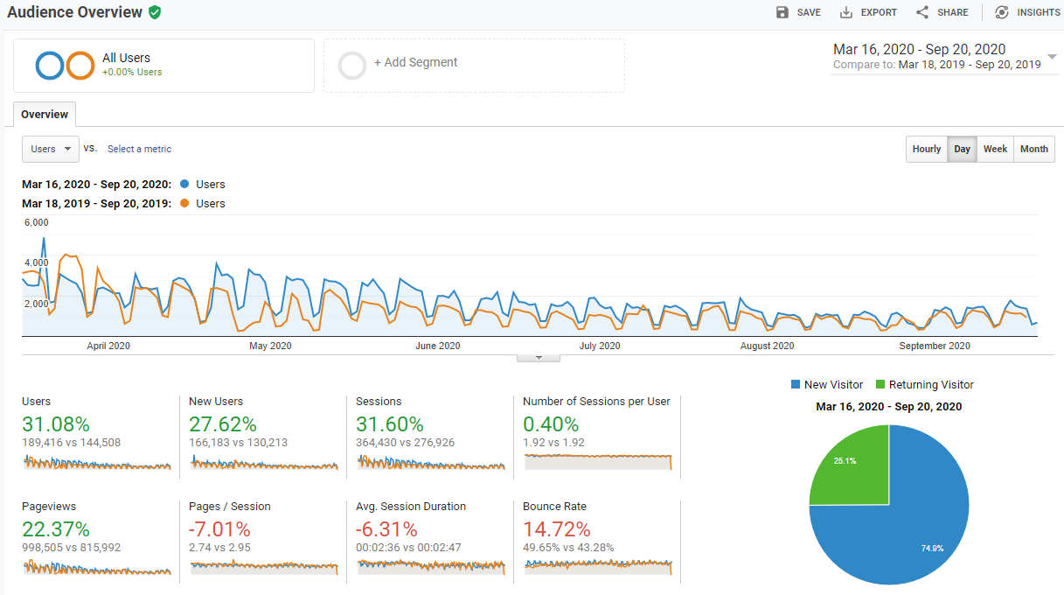
Visits of the website during March-September 2019 and 2020

Slide 16
Challenges
Emerging needs for new data
Budget constraints (esp. for PHC, AC, ITC)
Staff shortages; the moratorium on staff recruitment in 2019 and 2020
Inadequate ITC equipment/system
Methodological and operational challenges related to data collection. Increase in non-response rate for HH surveys
Access to administrative data sources and reduction of response burden
Implementation of the quality management
Need for an adapted approach to communicate with users

Slide 17
Opportunities
New data collection methods for HH surveys (CATI and CAWI)
Enhanced monitoring tools
Extended use of administrative data
Modernization of the technical & technological infrastructure
Use of new communication channels/tools for communication and statistical education

Slide 18
The need for statistics is an active role
in making the world of tomorrow.
Thank you
for your attention!
National Bureau of Statistics
of the Republic of Moldova
www.statistica.gov.md

